Slide 1
Signals and Communication Systems (24EC2105)
Analog Communications

Slide 2
AMPLITUDE MODULATION

Slide 3
Types of Amplitude Modulation
Non Linear AM
AM DSB FC
Amplitude Modulation
AM DSB SC
Linear
AM
SSB
VSB

Slide 4
Amplitude Modulation (AM)
The Amplitude Modulation (A.M.) is defined as a system of modulation in which the amplitude of the carrier is made proportional to the instantaneous amplitude of the modulating voltage.
DSB C: Double Side Band with Carrier
DSB FC: Double Side Band with Full Carrier
DSB LC: Double Side Band with Large Carrier
DSB TC: Double Side Band with Transmitted Carrier

Slide 5
Block Schematic Diagram of AM
.

Slide 6
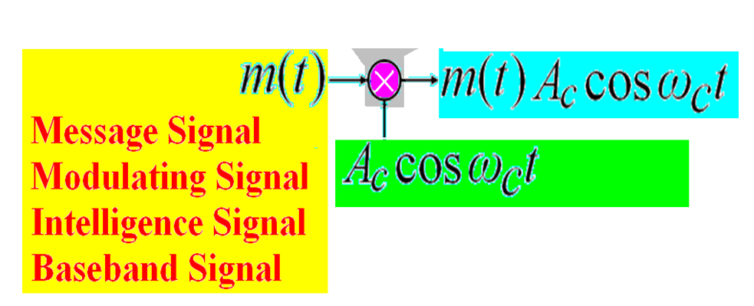

Slide 7
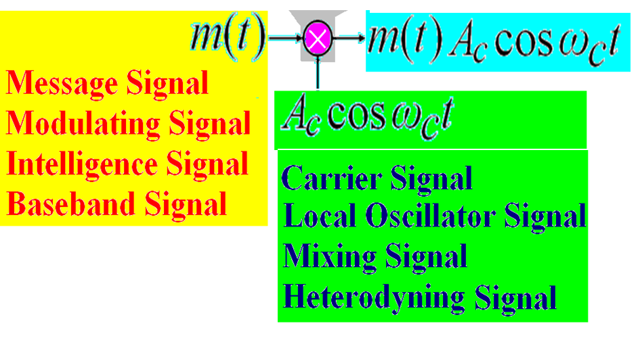

Slide 8
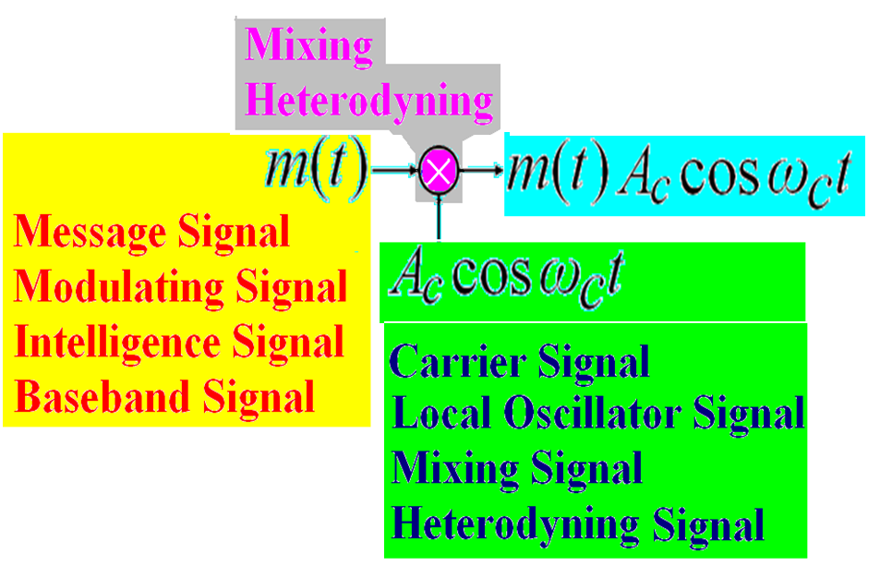

Slide 9
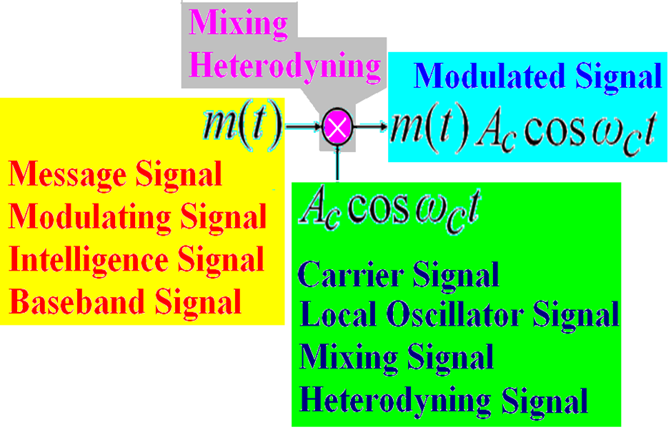

Slide 10
Time Domain Description:
The standard form of an A.M wave as a function of time is represented by

Slide 11
Case1: Single Tone Modulation
Let a message signal be
Time domain Representation
where
Modulation index

Slide 12
Frequency domain Representation

Slide 13
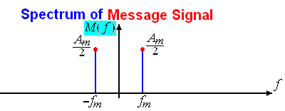
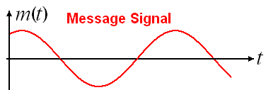
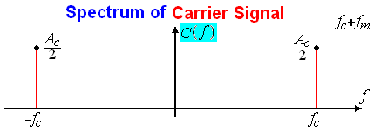
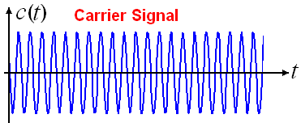
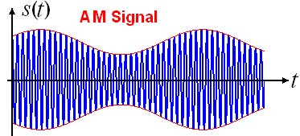
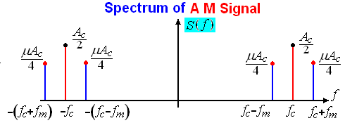
Single Tone Modulation

Slide 14
Transmission Bandwidth
The AM transmission bandwidth is defined as the frequency range occupied between upper sideband and lower sideband.
The AM transmission Band Width = USB – LSB =
which is the twice of the message signal frequency (or bandwidth).

Slide 15
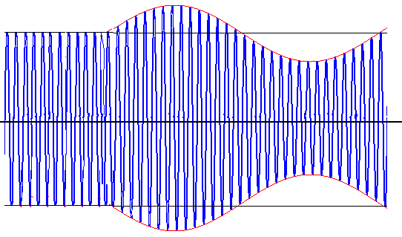

AM Signal
Carrier Signal
Modulating Signal

Slide 16
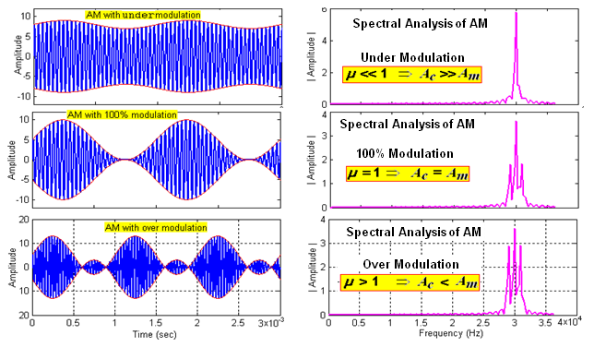
AM for various Modulation Indices

Slide 17
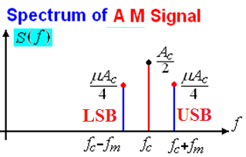
Power Relations in AM
where the total power,
carrier power,
lower sideband power
higher sideband power
Carrier Signal

Slide 18
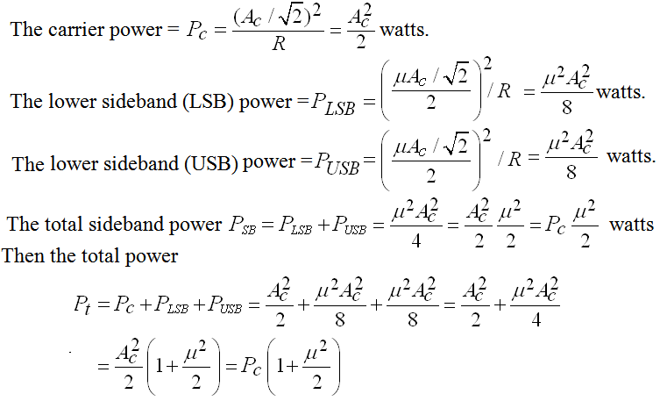
Power Relations in AM

Slide 19

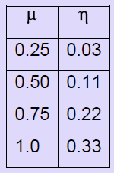
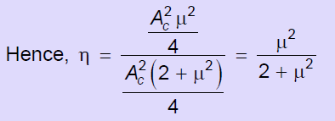
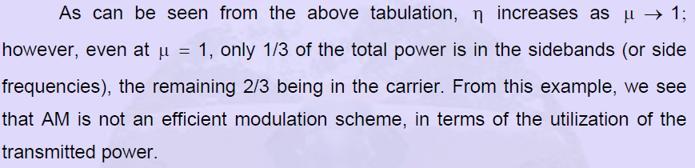
Transmission Efficiency of AM

Slide 20
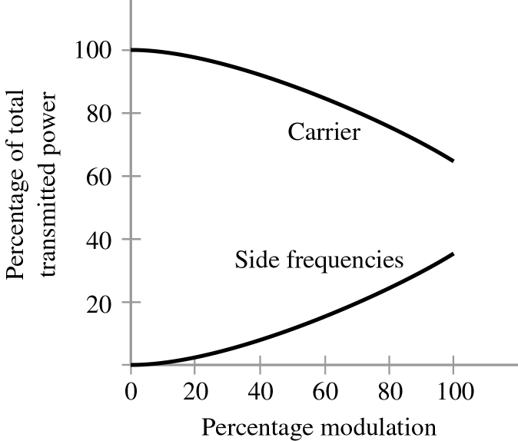
Carrier Power Vs Sideband Power

Slide 21
Current Calculations
Let be un-modulated current and be the total or modulated current of an AM transmitter both being rms values. If R is the resistance,

Slide 22
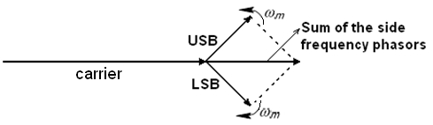
Phasor Representation of AM

Slide 23
Case2: Multitone Modulation
Let a message signal consists of three sinusoidal signals of different frequencies.

Slide 24
Case2: Multitone Modulation
The frequency domain representation Multitone modulation is expressed as

Slide 25
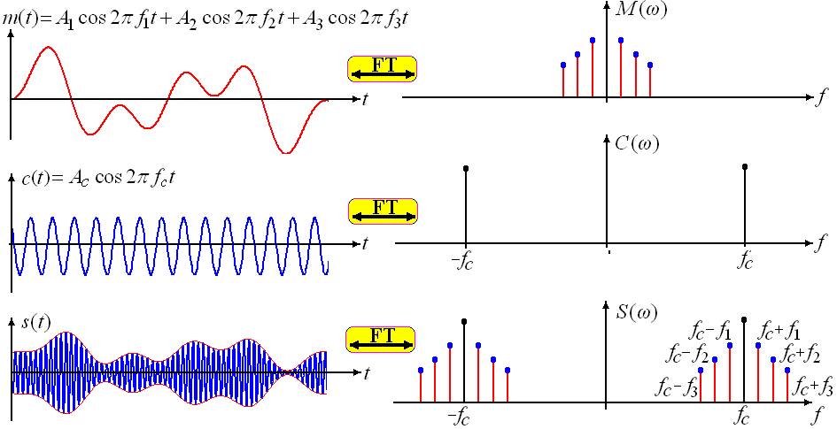
Case2: Multitone Modulation

Slide 26
Modulation Index for Multitone modulating signal
The total magnitude of several sinusoidal modulating signals may be represented as
By dividing by on both sides of the equation, we get
For three sinusoidal signals
and
In general

Slide 27
Case3: Baseband Signal Modulation
Let a message signal is band limited to ‘W’ Hz
Then AM signal is represented in time domain by
Frequency domain representation of AM wave is given by

Slide 28
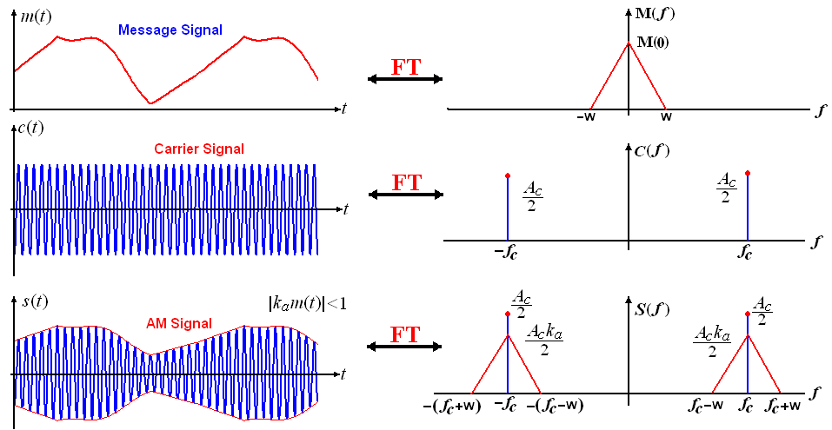
AM (Baseband Signal)

Slide 29
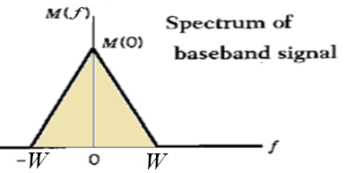
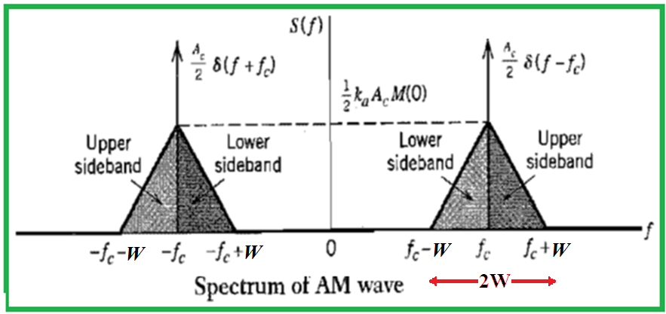
Transmission Bandwidth = USB-LSB = 2W

Slide 30
Conditions for AM
The amplitude of is always less than unity. That is for all t.
If envelope distortion is introduced.
2. The carrier frequency is much higher than that of message frequency W ,
Otherwise, envelope cannot be visualized satisfactorily at the receiver.

Slide 31
End

